Slide 1
Soft Computing(SWE1011)
J Component Review-1
Project Team:
20MIS1011 Kaviya S
21MIS1035 Rashmita Y
21MIS1017 Raj Koyani
21MIS1135 Abijith A

Slide 2
Abstract
Early detection and treatment of eye diseases are crucial for preventing vision loss and maintaining overall health.
Hence deep learning is a powerful tool in artificial intelligence, has shown significant promise in automating eye disease detection from fundus images.
This project explores the application of deep learning techniques for accurate and efficient identification of various eye diseases.
So the primary goal of our project is to develop an accurate and robust deep learning model for the classification of various types of eye diseases, specifically focusing on Normal, Cataract, Diabetic Retinopathy, and Glaucoma.
Healthcare professionals benefit from a user-friendly interface and interpretability features, leading to increased confidence in diagnoses.
This solution promises improved patient outcomes, reduced healthcare costs, and broader accessibility to advanced diagnostic tools

Slide 3
Modules
Backend:
Image Preprocessing: Resizes the image to a standard size. Converts the image to a suitable format for the deep learning model. Applies data normalization or augmentation techniques like ImageDataGenerator functionality for the model so after it is trained it will do Image Preprocessing
Deep Learning Model: Trained on a large dataset of labeled eye disease images. Using convolutional neural networks (CNNs) the predictions are done for the type of eye disease.
Result Processing: Interprets the model's output and translates it into user-friendly language.
API Communication: Frontend communicates with the backend through an API (e.g., RESTful). Sends the image data and receives the analysis results.
Frontend:
Image Upload: Input field for selecting an image file from the user's device. Support for various image formats (e.g., JPEG, PNG). Validation to ensure file size and type are within acceptable limits.
Submit Button: Initiates the image analysis process upon user click.
Results Display: Presents the predicted disease or shows if its healthy. It has clear and concise language, avoiding medical jargon where possible.

Slide 4
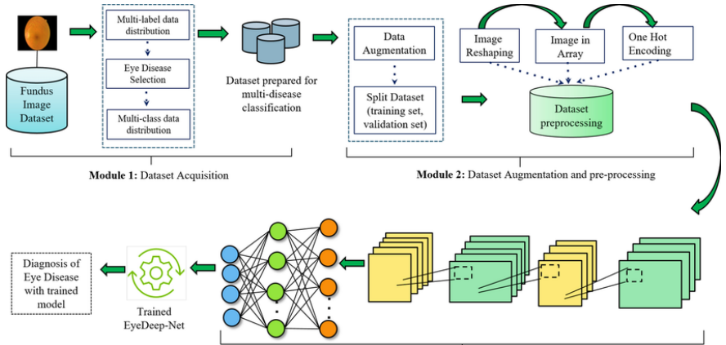
Flow/Block Diagram

Slide 5
Literature Survey
20MIS1011-Kaviya S
Paper 1: Retinal Eye Disease Detection Using Deep Learning
The authors highlight the importance of early detection and diagnosis of retinal diseases as they can significantly impact a patient's vision and overall quality of life. Traditional methods of diagnosis often require manual examination and interpretation of retinal fundus images by ophthalmologists, which can be time-consuming and subject to human error. Therefore, the researchers propose a deep learning model that can automatically classify retinal fundus images as healthy or diseased, without the need for explicit feature extraction or segmentation.
The proposed model utilizes neural networks and is trained on a dataset of labeled retinal fundus images. By learning from this dataset, the model can identify patterns and features associated with different retinal diseases. This approach improves the efficiency and accuracy of the detection process, potentially enabling early intervention and treatment.
The paper discusses the potential impact of the deep learning model in assisting ophthalmologists in diagnosing various retinal diseases, including conditions like diabetic retinopathy and retinitis pigmentosa. By automating the classification process, the model can provide valuable support to medical professionals, enhancing their ability to identify and manage these diseases.
Authors: Lorick Jain, H V Srinivasa, Chirayush, Devansh Bansal, Department of Computer Science, PES University, Bangalore, India
Research Paper Link: https://ieeexplore.ieee.org/abstract/document/9096838

Slide 6
Literature Survey
20MIS1011-Kaviya S
Paper 2: Optimized convolution neural network based multiple eye disease detection
The paper aims to improve the accuracy and efficiency of eye disease detection using deep learning techniques. It proposes an optimized CNN architecture specifically designed for the detection of various eye diseases. By leveraging the capabilities of CNNs to extract relevant features from retinal images, the authors aim to classify them into different disease categories.
Early detection and diagnosis of eye diseases are crucial for effective treatment and prevention of vision loss. The authors emphasize the significance of timely intervention, which can be facilitated by an optimized CNN model that enhances the accuracy and speed of disease detection.
The paper provides insights into the methodology used for training and evaluating the proposed CNN model. It discusses the dataset used for experimentation and the performance metrics employed to assess the model's effectiveness.
Authors: P. Glaret subin, P. Muthukannan
Research Paper Link: https://pubmed.ncbi.nlm.nih.gov/35751184/

Slide 7
Literature Survey
21MIS1035 Rashmita Y
Paper 3: An automatic system for early detection of diabetic retinopathy using fundus image analysis.
Despite the significant progress in deep learning-based approaches for eye disease classification, several challenges remain. Limited availability of annotated datasets, especially for rare eye diseases, poses a bottleneck for model development and evaluation.
Additionally, ensuring model interpretability and generalizability across diverse populations and clinical settings is essential for real-world deployment.
Future research efforts may focus on addressing these challenges by curating larger and more diverse datasets, developing interpretable deep learning architectures, and validating models in clinical practice.
By overcoming these challenges, deep learning techniques have the potential to revolutionize the early detection and management of various eye diseases, ultimately improving patient outcomes and reducing the burden on healthcare systems.
Authors: Sinthanayothin, C. et al.
Research Paper Link: https://www.ncbi.nlm.nih.gov/pmc/articles/PMC2881172/

Slide 8
Literature Survey
21MIS1035 Rashmita Y
Paper 4: Deep Learning System for Detecting Glaucomatous Optic Neuropathy Based on Color Fundus Photographs
A deep learning algorithm for detecting referable glaucomatous optic neuropathy (GON) based on color fundus photographs. We retrospectively included 48 116 fundus photographs for the development and validation of a deep learning algorithm. This study recruited 21 trained ophthalmologists to classify the photographs. Referable GON was defined as vertical cup-to-disc ratio of 0.7 or more and other typical changes of GON. The reference standard was made until 3 graders achieved agreement. A separate validation dataset of 8000 fully gradable fundus photographs was used to assess the model. The area under receiver operator characteristic curve (AUC) with sensitivity and specificity was applied to evaluate the efficacy of the deep learning algorithm detecting referable GON.
In the validation dataset, this deep learning system achieved an AUC of 0.986 with sensitivity of 95.6% and specificity of 92.0%. Misclassification as false-positive results of a normal-appearing fundus occurred in only 22 eyes (4.6%).
A deep learning system can detect referable GON with high sensitivity and specificity. Coexistence of high or pathologic myopia is the most common cause resulting in false-negative results. Physiologic cupping and pathologic myopia were the most common reasons for false-positive results.
Authors: Zhixi Li , Yifan He , Stuart Keel , Wei Meng , Robert T Chang , Mingguang He
Research Paper Link: https://pubmed.ncbi.nlm.nih.gov/29506863/

Slide 9
Literature Survey
21MIS1017 Raj Koyani
Paper 5: Deep Learning for Automated Detection of Diabetic Retinopathy Using Retinal Images
Deep learning techniques have emerged as powerful tools for the automated detection of diabetic retinopathy (DR) using fundus images. Diabetic retinopathy is a common complication of diabetes and a leading cause of blindness worldwide. Studies, such as the one conducted by Gulshan et al. (2016), have demonstrated the effectiveness of deep learning models in accurately detecting DR, even in its early stages.
These models leverage convolutional neural networks (CNNs) to analyze features within retinal images and classify them based on the severity of DR. The ability of deep learning algorithms to process large datasets of retinal images has facilitated the development of scalable screening programs for diabetic retinopathy, enabling timely intervention and management.
Authors: Gulshan, Varun et al.
Research Paper Link: https://www.ncbi.nlm.nih.gov/pmc/articles/PMC5961805/

Slide 10
Literature Survey
21MIS1017 Raj Koyani
Paper 6: Cataract Detection using Deep Learning Techniques.
Cataracts, characterized by clouding of the lens, are a common cause of vision impairment, particularly among older adults. Deep learning techniques have been applied to the automated detection of cataracts using features extracted from lens images.
Afshar et al proposed deep learning-based methods for cataract detection, demonstrating promising results in early diagnosis and intervention. By analyzing lens images for characteristic patterns indicative of cataracts, these models can assist clinicians in identifying individuals at risk and guiding appropriate treatment strategies.
Authors: Afshar, P. et al.
Research Paper Link: https://www.sciencedirect.com/science/article/pii/S2666914522000367#:~:text=The%20application%20of%20the%20slit,cataract%20diagnosis%20with%20visual%20acuity

Slide 11
Literature Survey
21MIS1135 Abijith A
Paper 7: Pre-trained Deep Learning-based Approaches for Eye Disease Detection
The research paper "Pre-Trained Deep Learning-Based Approaches for Eye Disease Detection" delves into the realm of utilizing deep learning methodologies for the early detection of eye diseases, a critical aspect in the field of ophthalmology. The authors highlight the significance of timely diagnosis in mitigating the progression of eye conditions and emphasize the shortcomings of conventional diagnostic techniques in terms of accuracy and efficiency.
The study involves an evaluation of the performance of these pre-trained deep learning models across different datasets representative of diverse eye diseases. Through rigorous testing and analysis, the researchers demonstrate the superior efficacy of the proposed deep learning-based approach compared to traditional diagnostic methods. The results showcase promising outcomes, with the deep learning models exhibiting high levels of accuracy in detecting a range of eye conditions.
By harnessing the power of pre-trained models and cutting-edge technology, the study paves the way for improved diagnostic accuracy, early intervention, and ultimately, enhanced patient outcomes in the field of ophthalmology.
Authors: Pankaj Kumar, Vishal Dutt,
Research Paper Link: https://www.researchgate.net/publication/374107310_Pre-Trained_Deep_Learning-Based_Approaches_for_Eye_Disease_Detection

Slide 12
Literature Survey
21MIS1135 Abijith A
Paper 8: Support Vector Machine Based Method for Automatic Detection of Diabetic Eye Disease using Thermal Images
The research paper titled "Support Vector Machine Based Method for Automatic Detection of Diabetic Eye Disease using Thermal Images" by Dr. D. Selvathi presents a method for automatically detecting diabetic eye disease using thermal images. The proposed system utilizes supervised machine learning techniques, specifically Support Vector Machine (SVM) classification, to classify thermal images of eyes as either "Normal" or "Diabetic Diseased Eye."
The methodology involves several key steps. Firstly, thermal images are captured using a FLIR T400 thermal camera, with a dataset comprising 283 eye images, including 149 images of diabetic patients and 134 images of normal individuals. Pre-processing techniques such as color conversion (RGB to Gray and RGB to HSI), Histogram Equalization (HE), and Discrete Wavelet Transform (DWT) are applied to extract relevant features from the images.
The SVM classifier is then trained on these extracted features to distinguish between normal and diabetic diseased eyes. The paper discusses the use of K-Fold Cross-Validation by dividing the dataset into k folds and iteratively training and validating the model. In conclusion this research paper introduces a novel approach to automatically detect diabetic eye disease.
Authors: Dr. D. Selvathi, K Suganya
Research Paper Link: https://ieeexplore.ieee.org/document/8741450

Slide 13
J Component Review-2(Extension)

Slide 14
Progress until Review-2
The primary goal of our project is to develop an accurate and robust deep learning model for the classification of various types of eye diseases, specifically focusing on Normal, Cataract, Diabetic Retinopathy, and Glaucoma.
So, keeping that in mind we developed a eye disease detecting model using Restnet59
We have used ImageGenerator for the preprocessing of dataset so that it can easily segregate into the 4 classes which are Glaucoma, Diabetes Retinopathy, Cataract and normal.
So far we have trained the model, saved the results into a flask model and tested the model and obtained the following results:
Class-level accuracies:
cataract: 0.8618
diabetic_retinopathy:
0.9822 glaucoma:
0.7344 normal: 0.8266

Slide 15
Progress until Review-2
Next, we have used HTML, CSS, JavaScript for the frontend of our website.
We ran the model with 50 epochs and 99 rounds in each epoch. The optimiser we used was Adam and crossentropy as the loss function and obtained excellent results and an accuracy of 95%
By Review-3
Further by the time of complete model deployment in review 3 we would integrate the frontend and backend using the flask and streamlit and display our final results.
Using the local host and the saved model’s file, we will host the model into a full fledged working website

Slide 16
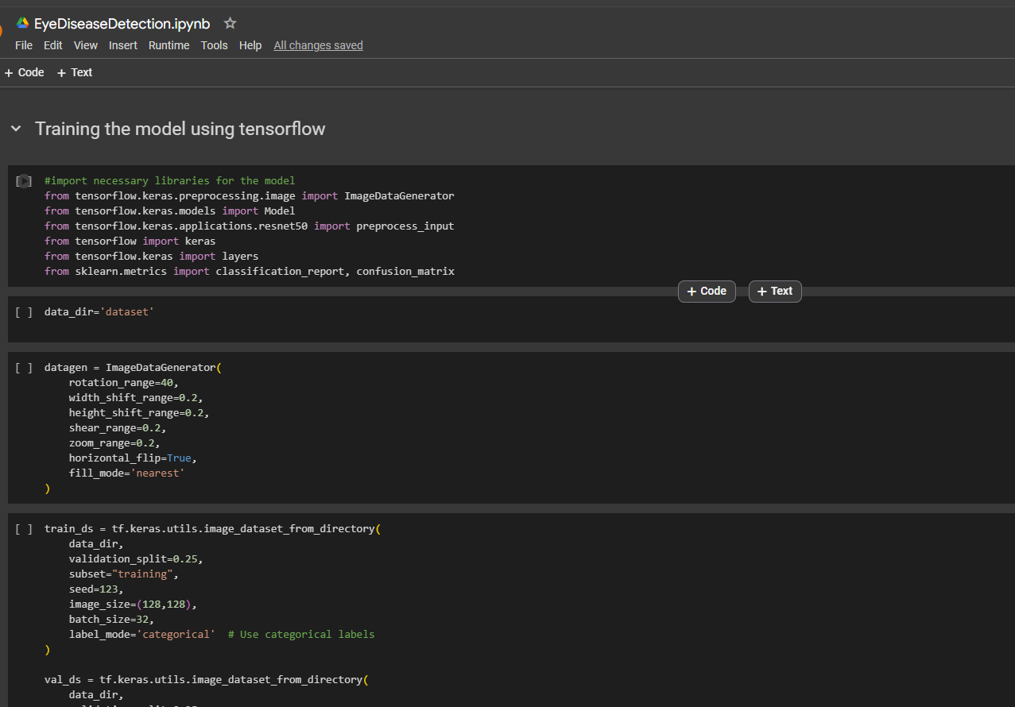
Training the Model

Slide 17
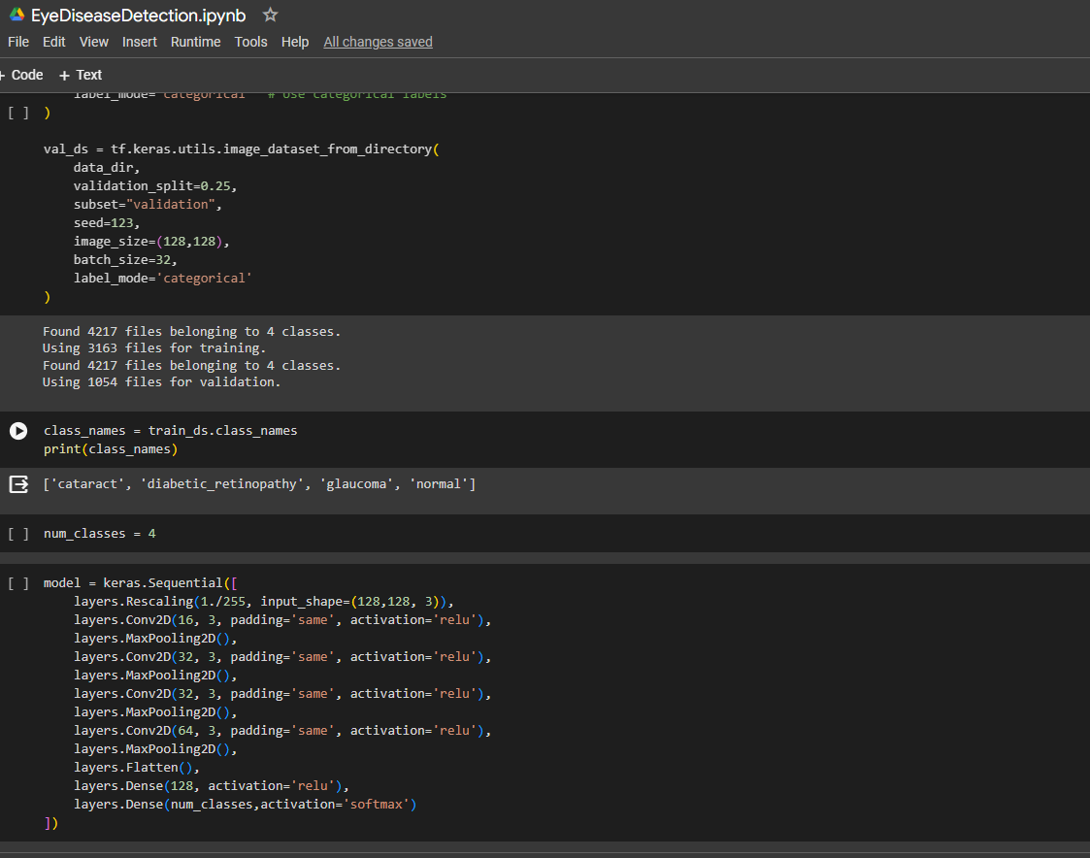
Training the Model

Slide 18
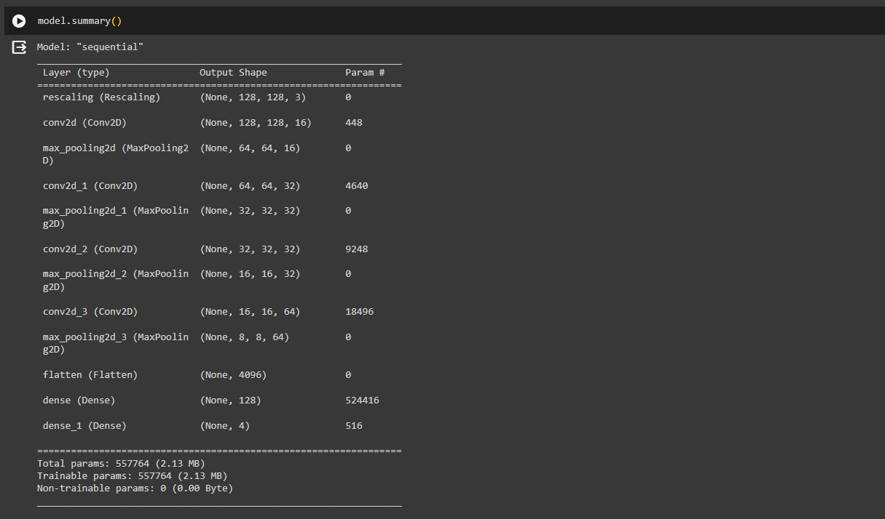
Model Summary

Slide 19
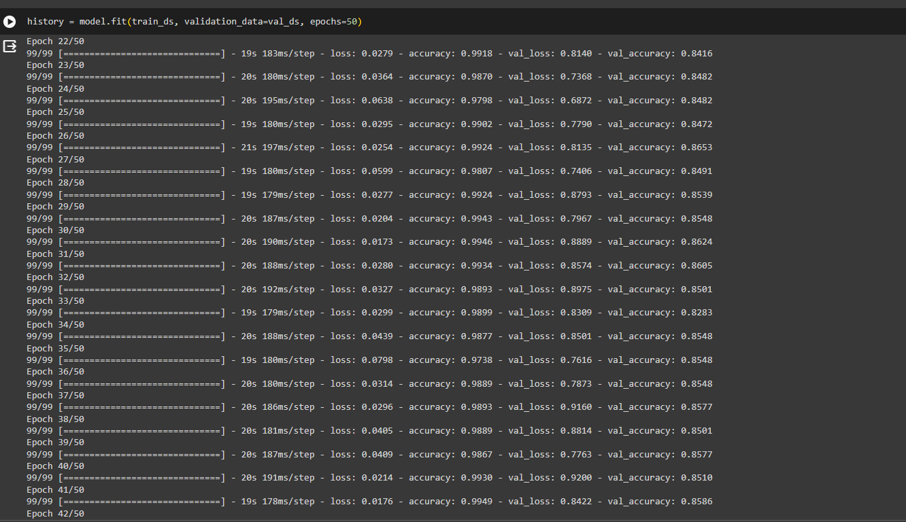
Model training

Slide 20
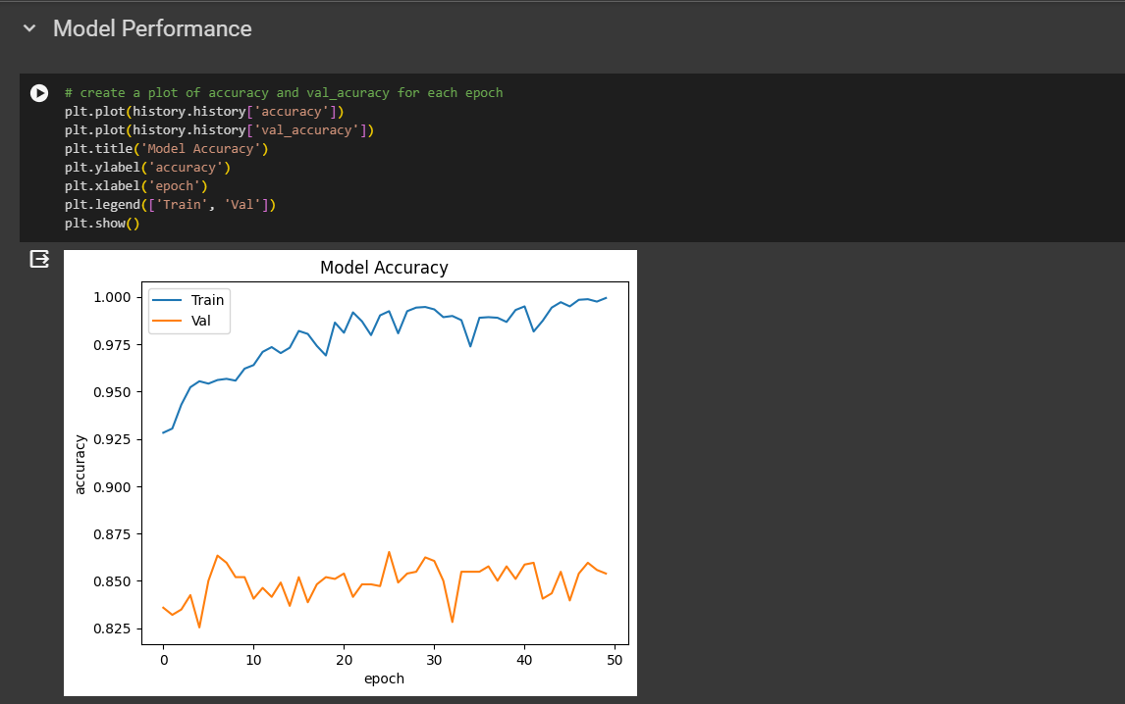
Evaluating Model Performance

Slide 21
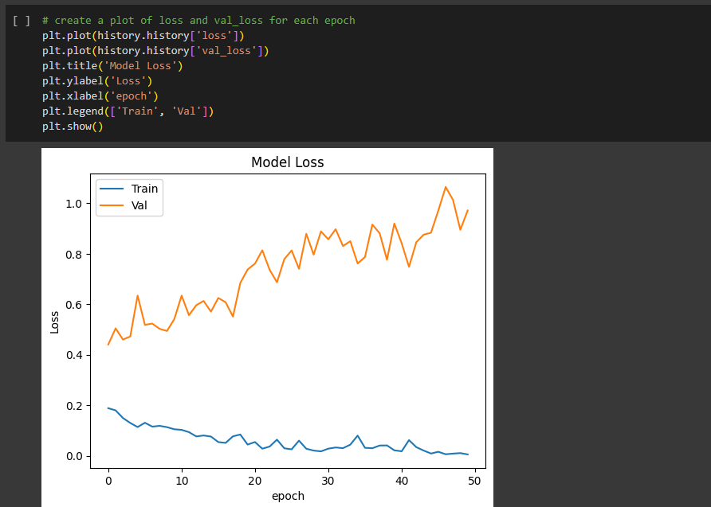
Evaluating Model Performance

Slide 22
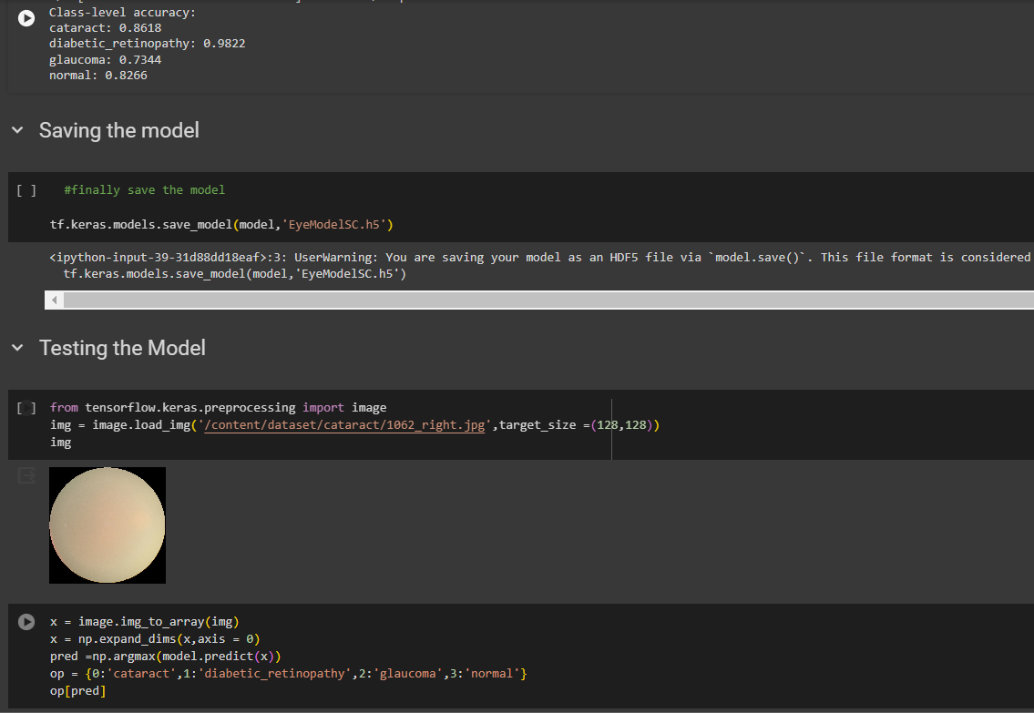
Saving the Model and Testing

Slide 23
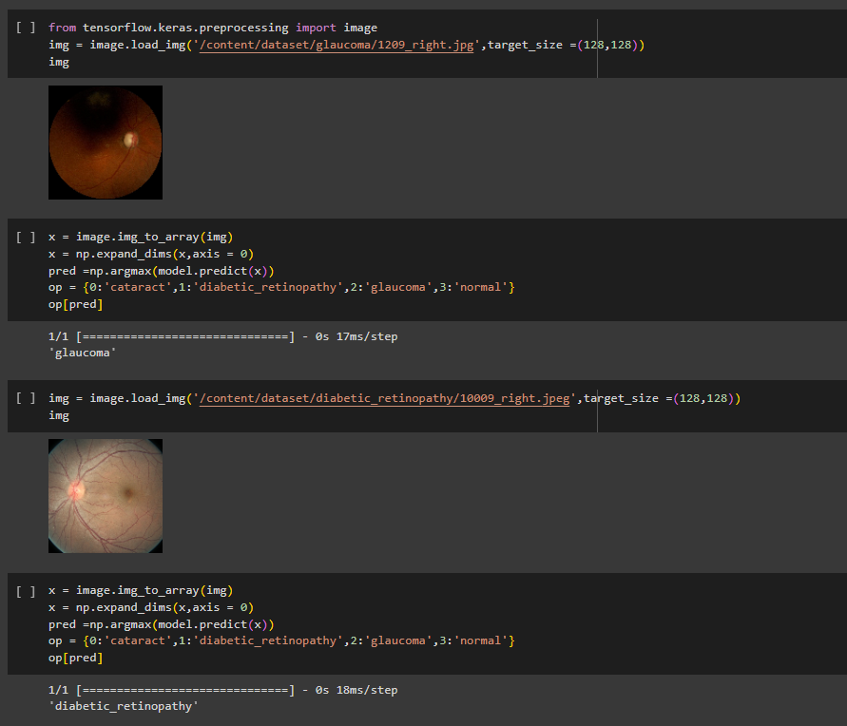
Results

Slide 24
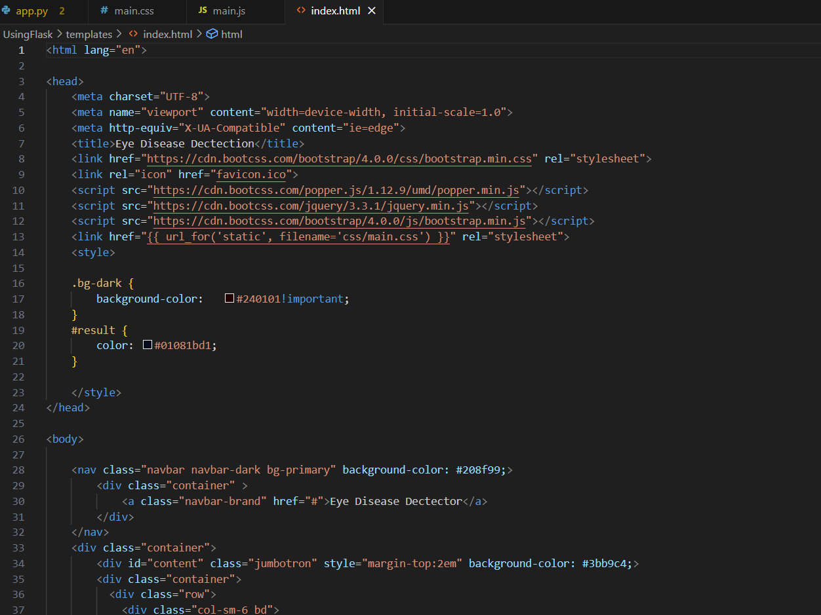
Frontend Development
We have coded the above three files in HTML, CSS and JavaScript, we are yet to integrate it with our model

Slide 25
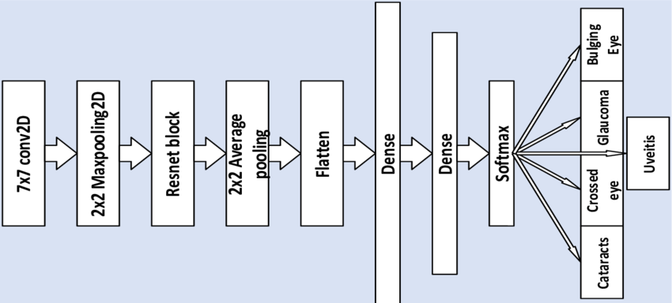

Architecture Diagram
Normal
Diabetic Retinopathy

Slide 26
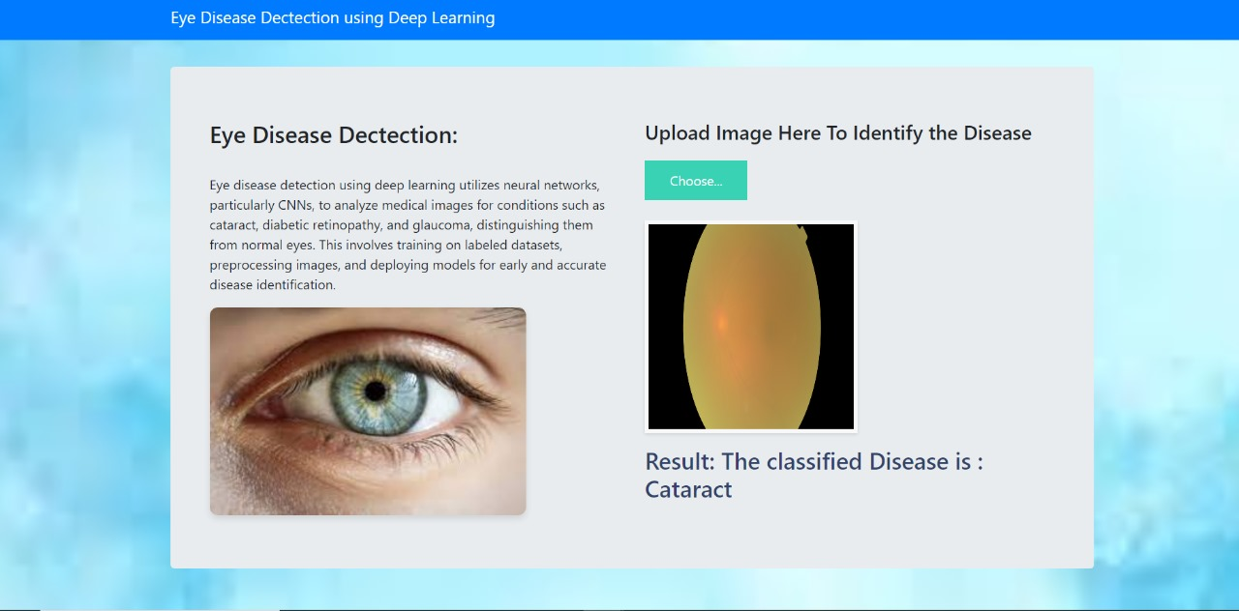

Slide 27
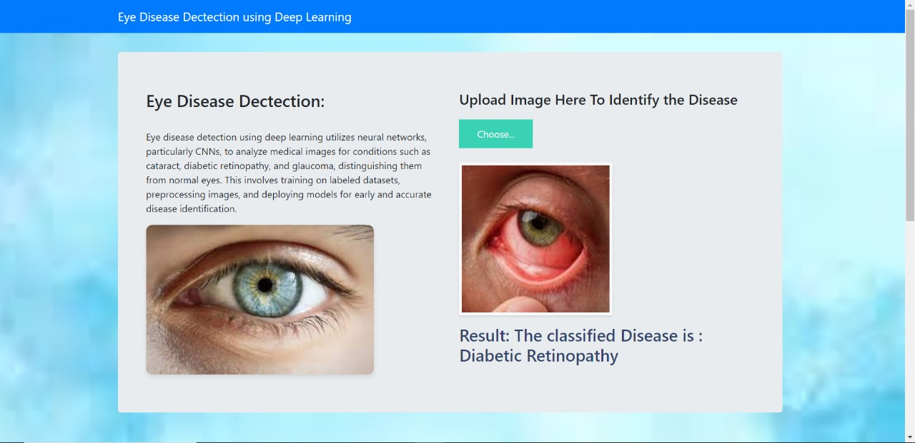

Slide 28
Thank you

